Slide 1
JavaScript Basics: An Introduction
JORDAN SZALONTAI – 2020. 03. 16.
Based on the work of Judit Bartha
CONFIDENTIAL | © 2020 EPAM Systems, Inc.

Slide 2

Who am I?
Software Engineer at EPAM Systems
Working at EPAM since August 2018
JavaScript (UI) developer
Graduated at the University of Debrecen (Computer Science BSc)
Available for questions at Jordan_Szalontai@epam.com

Slide 3
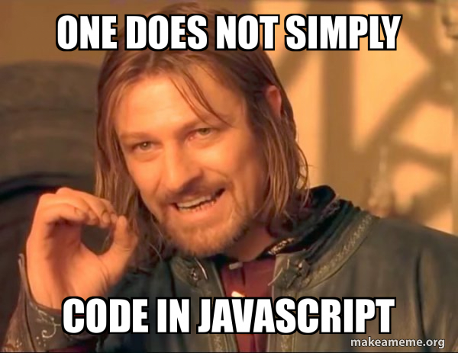
Agenda
1.
SCOPES & This
2.
Objects & Prototypes
3.
Hoisting
4.
Closures
5.
modules

Slide 4
SCOPES & THIS

Slide 5
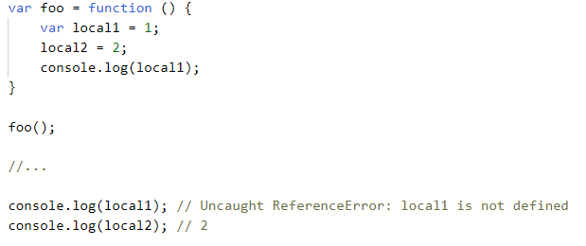
Scopes
We know from other languages that there are scopes, in which variables make sense
Scopes can be local funcion scope or global scope

Slide 6
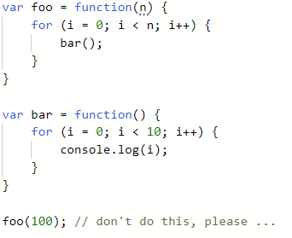
Scopes
You can interpret scopes as scope of an object (even functions are objects)
In browsers, the global object is the window¹
Variables without the var identifier become global (window scope)²
Variables with the var identifier are in the scope of their function (if not in a function, they are in the window scope)³
1 - in Node.js, it is called global
2 - you cannot declare a variable without identifier if you ’use strict’
3 - ES6 introduces let and const as local scope variables
Notice the missing identifiers before i

Slide 7
Functions?
To better understand scopes & this first we should understand how functions behave
There are function declarations, and function expressions
Functions are first-class citizens of JavaScript === can be passed as an argument
&& can be returned
&& can be assigned to a variable

Slide 8
Functions
Unlike in Java, and others, in JavaScript the number of arguments passed to a function depends on the caller of the function (not the declaration of function)¹
In every Function arguments is a keyword that refers to the arguments that the function is going to receive
In every Function this is a special context variable of the function^{2,3}
1 - IDEs, TypeSciprt, etc. will warn the developer if they try to make something sily because of this fact
2 - If referenced outside all functions, this will refer to the window/global scope
a) there can be special cases, like Events, where people claim that this references the DOM element of the Event, but this can be deduced from function scopes
b) in strict mode this is undefined by default, in not strict mode, it is the global object by default
3 - ES6 arrow functions also have a this, which is equal to the this of its context (arrow function in window scope will have a this referencing the window object)

Slide 9
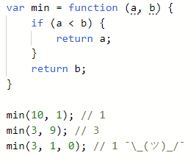
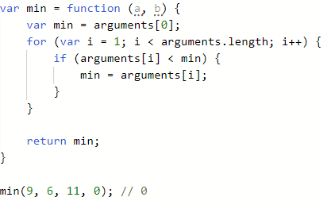
How to call a function
These are just fancy names
Let’s create the following function:

Slide 10
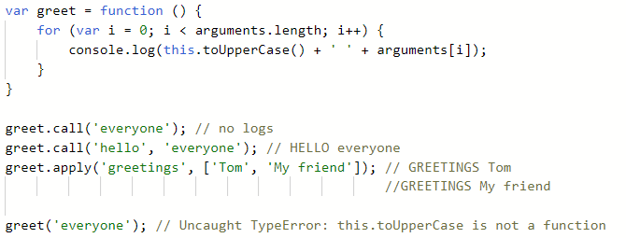
How to call a function
There are three special functions on a Function object: call, apply, and bind
They have N+1 arguments, where the first argument is for the this context variable and N is the length of the original function’s arguments

Slide 11
How to call functions
Let’s take a look at some code!

Slide 12

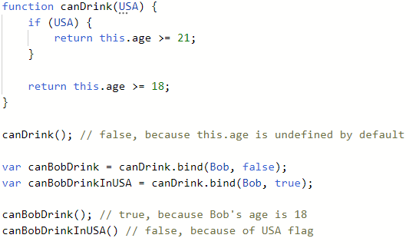
How to call a function
Out of three, bind is the only one that does not call the original function, instead makes a copy of it, with the new this context

Slide 13
This is not a problem, this is a feature.
- Venkat Subramaniam, 2016 https://www.youtube.com/watch?v=aIVKX5SeLoE

Slide 14
Objects & prototypes

Slide 15
How to create an object in JavaScript?
There are several ways to create a new object in JavaScript
Object literals
Object constructor
Object.create()
Object.defineProperty()¹
Object.defineProperties()
Object.assign() ¹
1 – These slides will not cover in depth this function, but you will see examples, as this is pretty straightforward

Slide 16
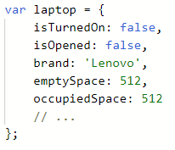
Object literal
Straightforward (JSON like) syntax
Properties can be functions as well

Slide 17
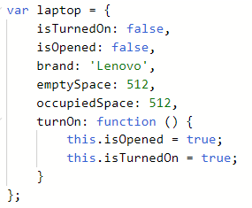
Object literal
Straightforward (JSON like) syntax
Properties can be functions as well
Simplicity, more readable

Slide 18
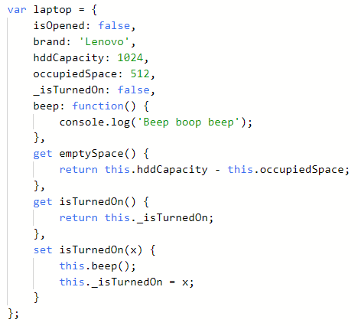
Object literal
Note: there are special access descriptors
get
set
These are special functions which serve as getter/setter
Both undefined by default
The return value of get is the return value of the getter function and is used as a value
The set recieves one argument which could modify a parameter in a custom way.
Good for factories
Component can emit after a set

Slide 19
Object literal
Let’s take a look at some code!

Slide 20
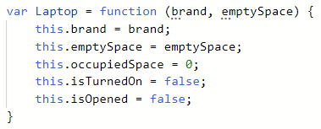
Object constructor
An object constructor is just a function
Notice the var name starting with a capital letter

Slide 21
Object constructor
This is a function expression so this can be called without any errors, but this is not enough: Laptop();
Create a new instance with this constructor using: var laptop = new Laptop(’Lenovo’, 1024);

Slide 22
Object constructor – What happens?
Allocate memory for laptop
Laptop.call(laptop, ’Lenovo’, 1024)
laptop.__proto__ = Laptop.prototype
var laptop = new Laptop(’Lenovo’, 1024);
new property on the new instance
prototype on the constructor

Slide 23
Object contructor – What happens
Let’s take a look at some code!

Slide 24

Prototypes & inheritance
JavaScript is often described as a prototype-based language — to provide inheritance, objects can have a prototype object, which acts as a template object that it inherits methods and properties from.
Whenever there is a new object created in Javascript, the engine adds the __proto__ property to the function.
Points to the prototype object of the constructor function

Slide 25
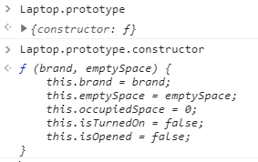
Prototypes & inheritance
Whenever there is a new function created in Javascript, the engine adds the prototype property to the function.
Has a constructor property by default
The constructor property points back to the function on which prototype object is a property

Slide 26
Prototypes & inheritance
Laptop { // ...
prototype }
some prototype object { constructor
// ... }
https://developer.mozilla.org/en-US/docs/Web/JavaScript/Inheritance_and_the_prototype_chain https://medium.com/better-programming/prototypes-in-javascript-5bba2990e04b
laptop { brand: ’Lenovo’, // ...
__proto__ }
laptop.__proto__ === Laptop.prototype

Slide 27
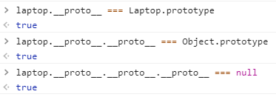
The prototype chain
Prototype objects can have a prototype object
This creates a prototype chain
Getting a property from an object (e.g. laptop.brand)
instance itself has property?
Yes → return property
No → continue with step 2
prototype is null?
Yes → continue with step 3
No → continue with step 1, but use the prototype as the instance
return undefined

Slide 28
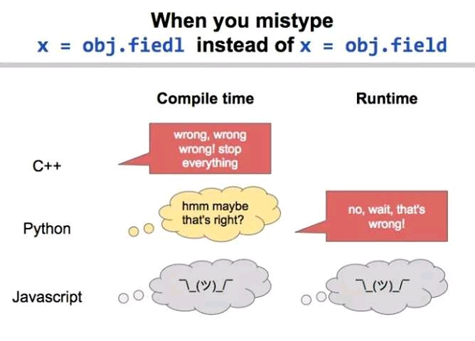

Slide 29
Prototypes & inheritance
Remember that every time an object is created with a contructor function, the object itself and its properties will be „brand new”.
Meaning that every function that is a property will get created over and over again. (imagine this with 100s of objects... how wasteful)
Objects created with the same constructor share prototype, defining properties on the prototype is possible with the dot or the square bracket notation.

Slide 30
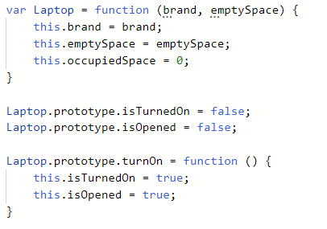
Prototypes & inheritance
Let’s try to create multiple instances with this class
Let’s try to invoke method’s from the prototype
If they really share prototypes (instance1.__proto__ === instance2.__proto__) would an instance affect others when invoiking a function?

Slide 31
Prototypes & inheritance
Let’s code!

Slide 32
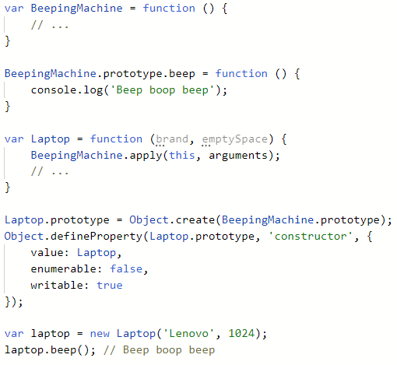
Prototypes & inheritance

Slide 33
Hoisting

Slide 34
Hoisting
MDN web docs says (this is what you would say in an interview):
„Hoisting was thought up as a general way of thinking about how execution contexts (specifically the creation and execution phases) work in JavaScript.”
„[...] variable and function declarations are physically moved to the top of your code [...]”
„variable and function declarations are put into memory during the compile phase, but stay exactly where you typed them in your code”
Simplified (this is what you say when you understand this concept)
Whenever you write function or var, just imagine what would happen if declaring it on the top of your file/function ☺

Slide 35
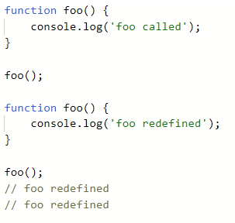
Hoisting
Let’s take a look at the following code snippet:
Again, this is a feature, not a problem

Slide 36
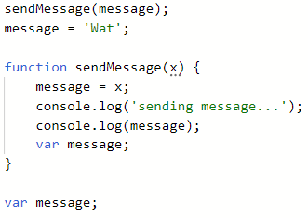
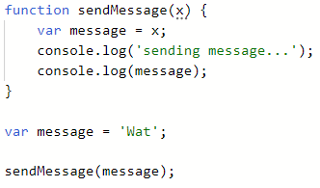
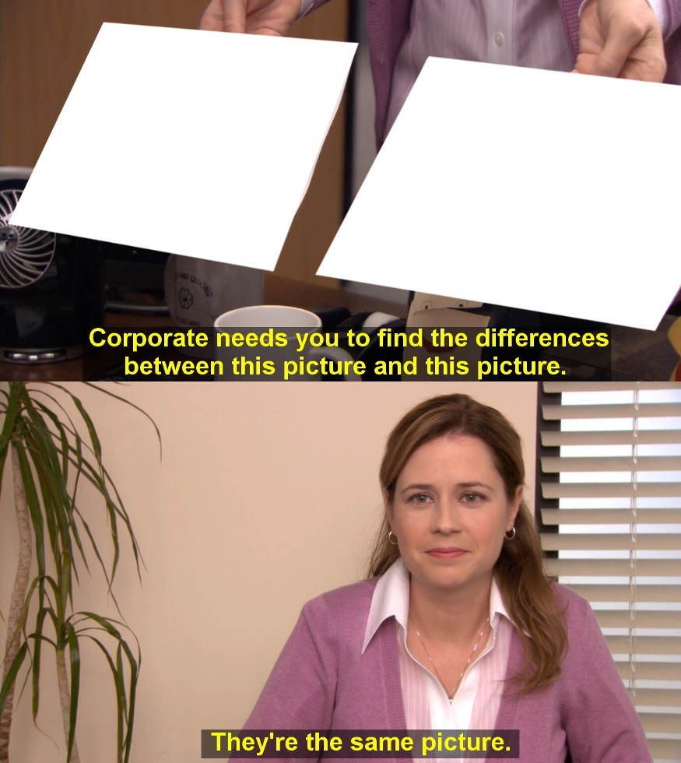

Hoisting

Slide 37
closures

Slide 38
Closures
Since a function defines a scope, we can achieve different closures with embeding functions in each other (wrapping one with other)
This way local variables make sense (but their scope will be still function scope!)
Working with objects and „classes” often has the word „closure” associated with them
public things
private things
etc.

Slide 39
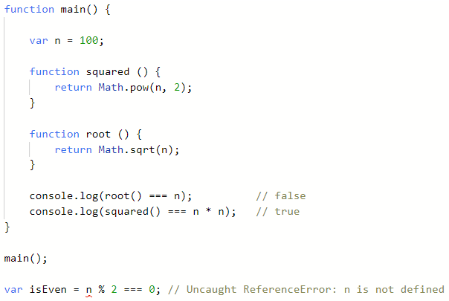
Closures
n makes sense only in the closure of the main function
n also makes sense inside the functions of the main function
n does not make any sense outside

Slide 40
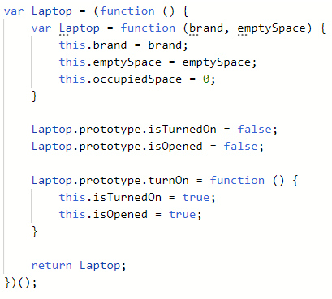
Closures
Creating a class would look like this
Note: to have a real private variable in a closure, the most common practice is to wrap the constructor function with an IIFE, or you can create factories if you just wrap your constructor in a function expression

Slide 41
Es5 modules

Slide 42
Modules - History
MDN says:
„[...] usage in the early days was to do isolated scripting tasks [...]”
„[...] we now have complete applications being run in browsers with a lot of JavaScript, as well as JavaScript being used in other contexts (Node.js, for example).”
The need came for organising the code well, separating concerns, namespaces, reusability etc.

Slide 43
Modules
The module pattern is the most common design pattern used in JavaScript
It creates encapsulation of the code
Node.js had its module system for a long time, but other client side frameworks were made as well
RequireJS
Webpack
Babel
These approaches require some configuration files in order to work properly after that you can have nice module structures

Slide 44
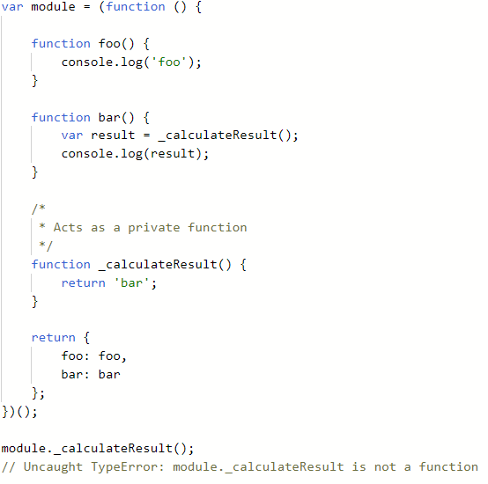
Modules
Without any customization and frameworks it is still possible to write modules
Creating a module like object may look like this:

Slide 45
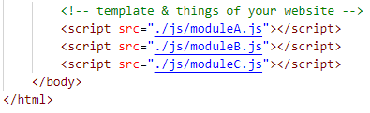
Modules
You still need to somehow let the browser know that you want that piece of code to work
You might have dependencies
module-A depends on module-B, and both depend on module-X
the order of the scripts is important as this will get interpreted by the browser synchronously (e.g. we couldn’t use moduleC in moduleB on the right)

Slide 46
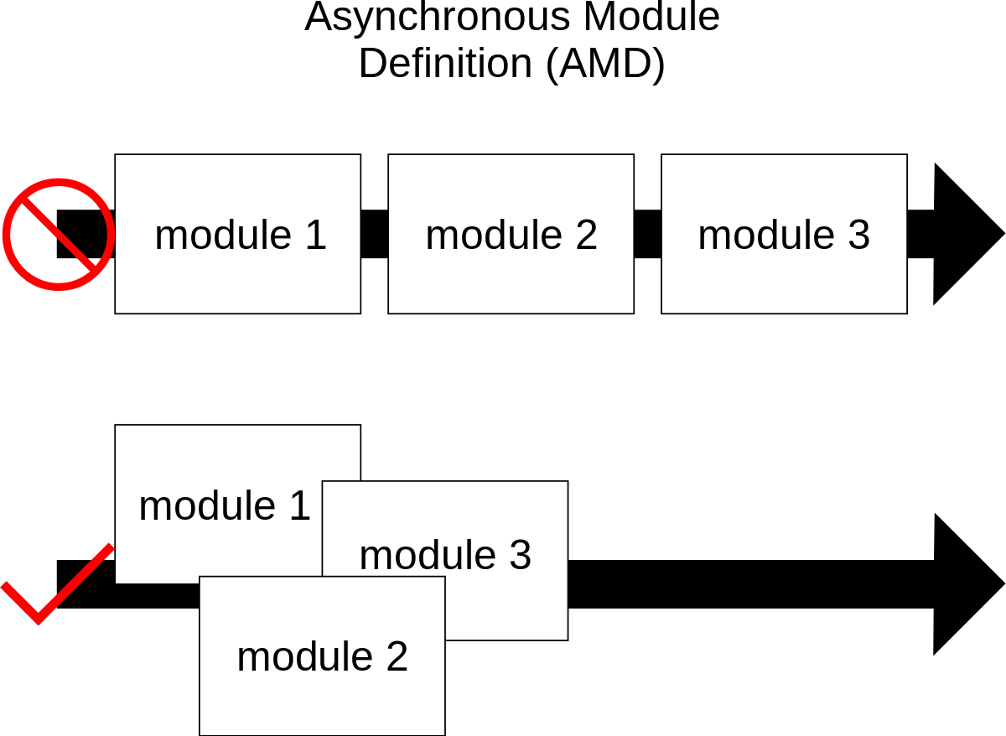
Asynchronous Module Definition
load modules asynchronously
using script tags blocks the page, as it loads until the DOM is ready
allows the DOM to continue loading, while the scripts are also still loading
the most popular implementation of AMD is RequireJS

Slide 47
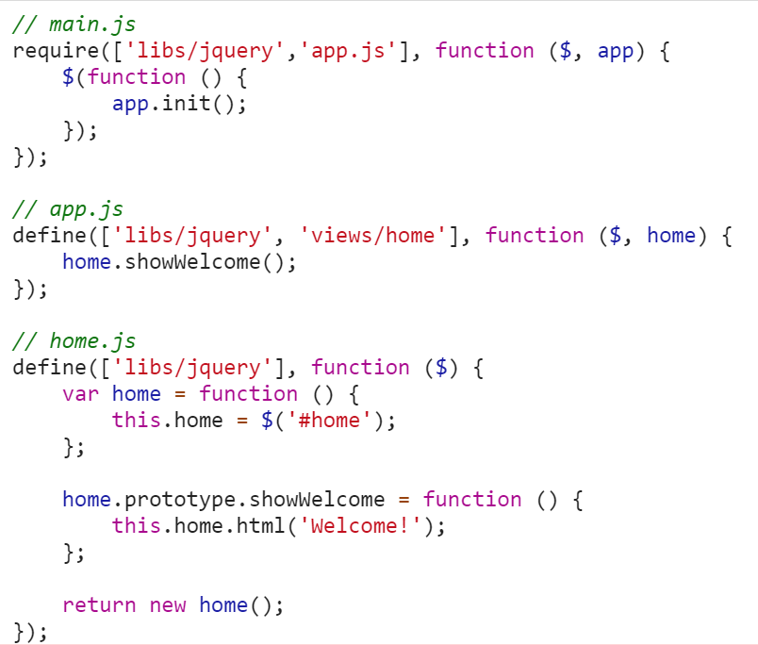
RequireJS

Slide 48

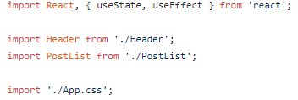
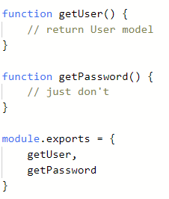
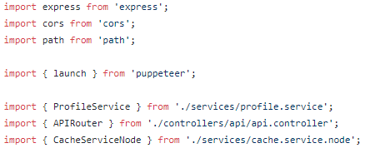
Nowadays...

Slide 49
Takeaway

Slide 50

Takeaway
JS is a very powerful language with lots of possibilities
Do we really need to know all of the previous??
yes
Most JS frameworks make use of module frameworks/libraries like Webpack
ES6+ is great, but the core functionality did not change
lots of syntax sugar was added
Experiment and play to fully understand this

Slide 51
Takeaway
Useful links:
Venkat Subramaniam - Discovering JavaScript
https://www.youtube.com/watch?v=aIVKX5SeLoE
defineProperty:
https://developer.mozilla.org/en-US/docs/Web/JavaScript/Reference/Global_Objects/Object/defineProperty
Function.prototype.call/apply/bind:
https://developer.mozilla.org/en-US/docs/Web/JavaScript/Reference/Global_Objects/Function/call
https://developer.mozilla.org/en-US/docs/Web/JavaScript/Reference/Global_Objects/Function/apply
https://developer.mozilla.org/en-US/docs/Web/JavaScript/Reference/Global_Objects/Function/bind
Inheritance in JS:
https://developer.mozilla.org/en-US/docs/Learn/JavaScript/Objects/Inheritance
Hoisting:
https://developer.mozilla.org/en-US/docs/Glossary/Hoisting
This:
https://developer.mozilla.org/en-US/docs/Web/JavaScript/Reference/Operators/this
Anything:
Google → javascript [type anything here] mdn → first result

Slide 52
Köszönöm a figyelmet!

